Slide 1
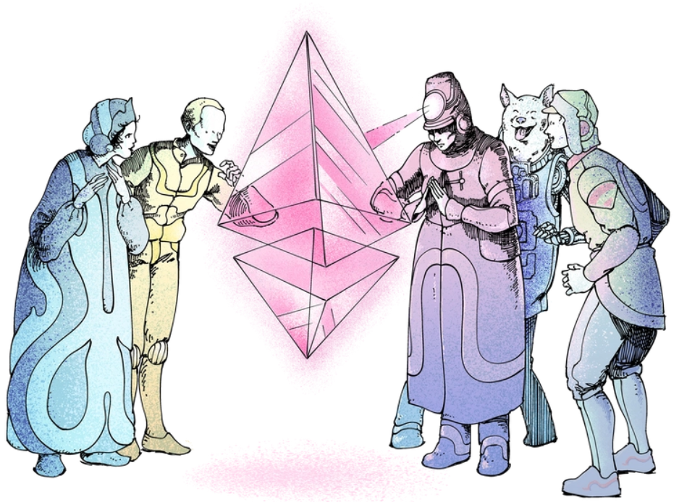
Wallets y Tokens Andy Guzman, PSE

Slide 2
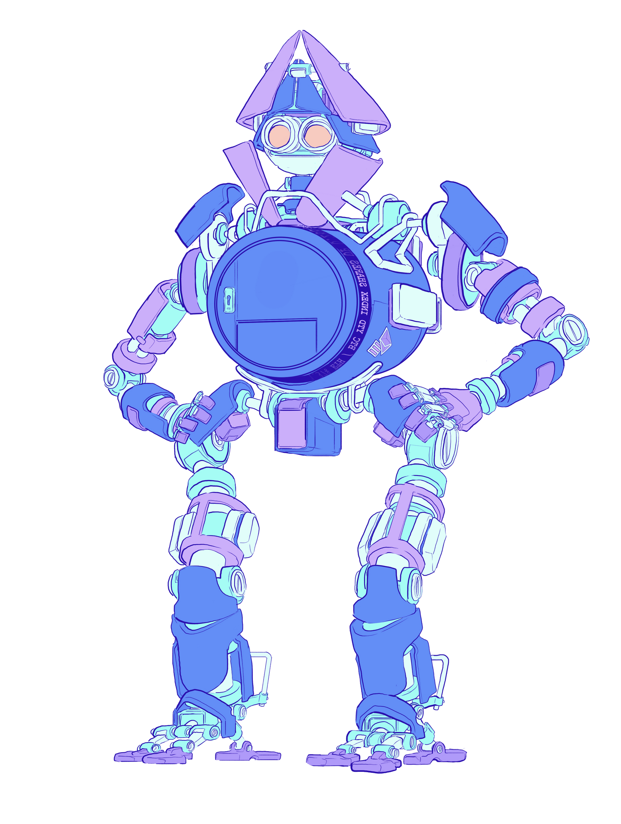
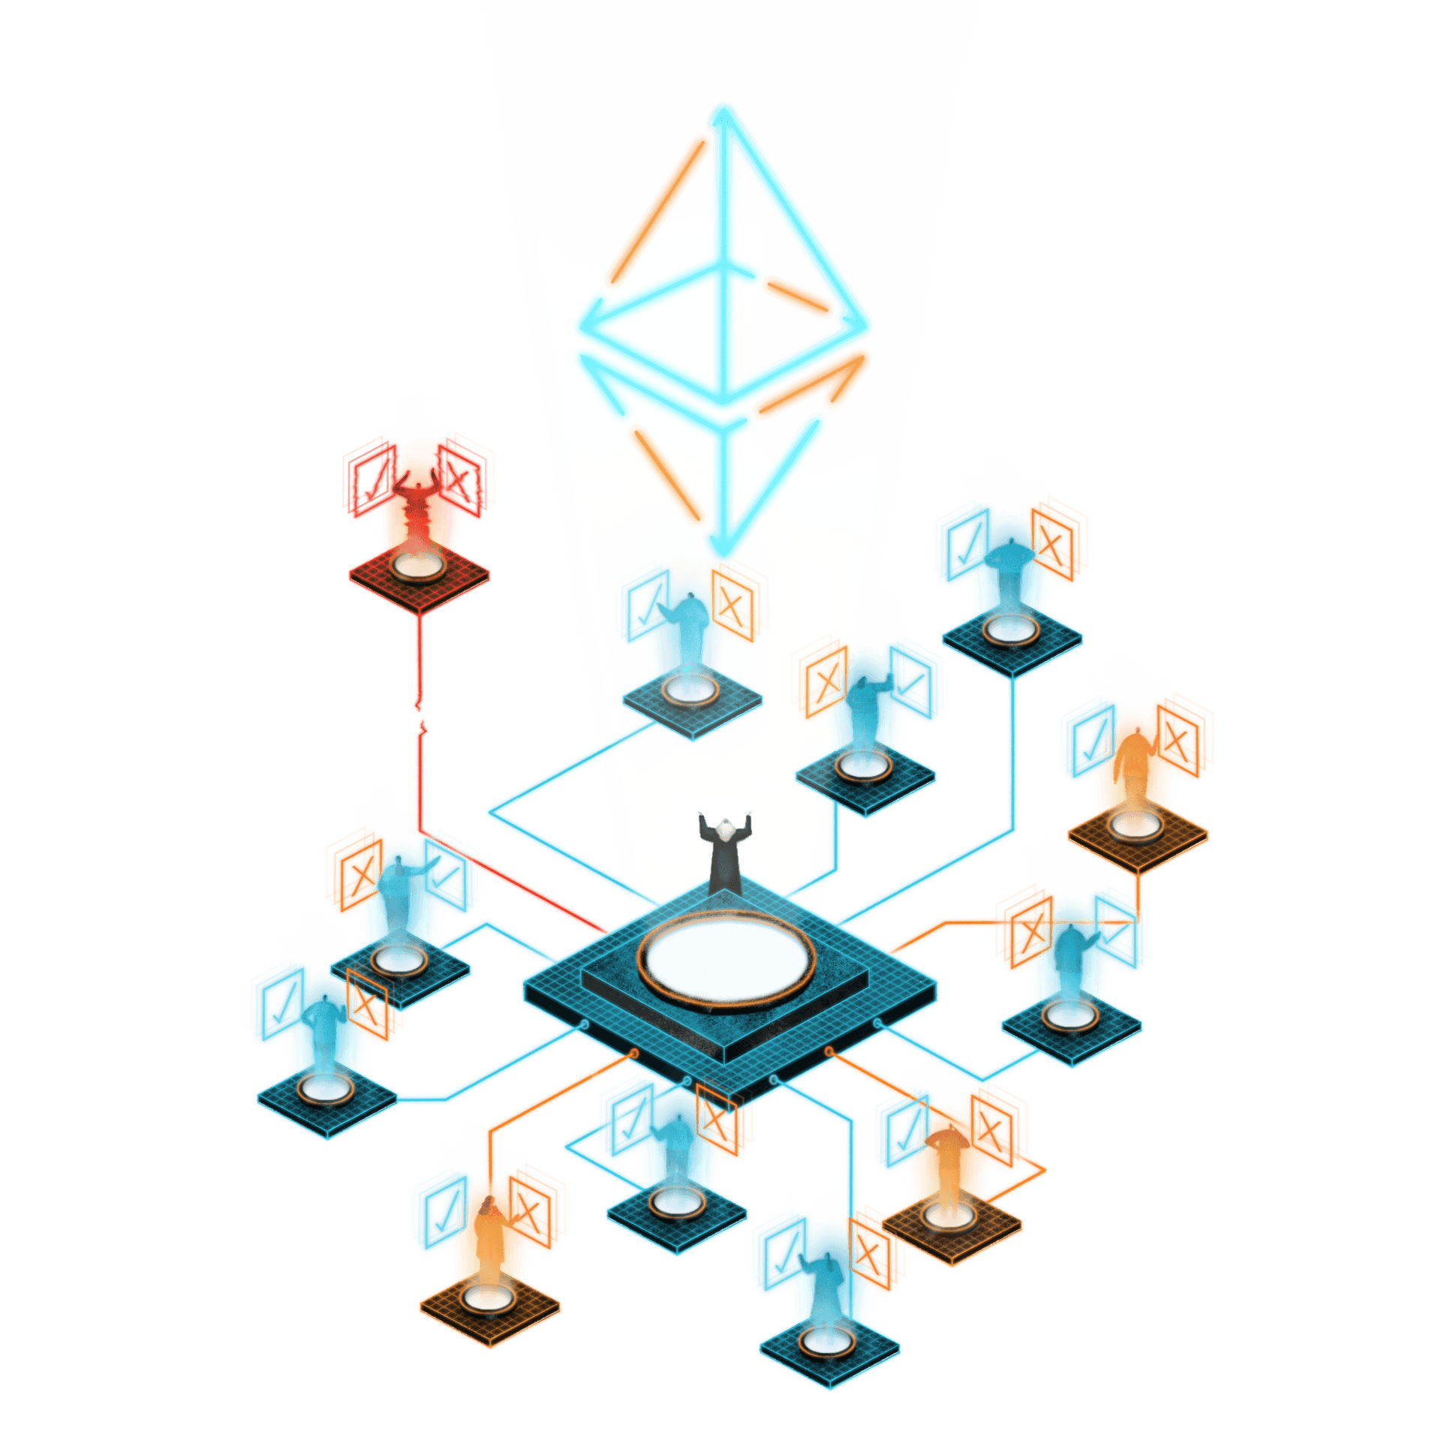
Wallets
Tokens
¿QUE ES UN TOKEN?
TIPOS DE TOKEN
EJEMPLOS DE TOKENS
NFT
MERCADOS DE TOKENS
ESTANDARES
SBT
CONSIGUIENDO MI PRIMER TOKEN
Notes:
Agenda de Tokens
¿QUE ES UN TOKEN?
TIPOS DE TOKEN
EJEMPLOS DE TOKENS
MERCADOS DE TOKENS
RETOS Y PROBLEMAS
CONSIGUIENDO MI PRIMER TOKEN
El largo de la presentacion no lo he medido, espero 25min. Pueden hacer preguntas cuando quieran.

Slide 3



Tokens
Definición financiera
Definición común
Definición técnica
Una primera definición dice que “token” es un sinónimo de criptomoneda o cripto-activo.
Una segunda definicion y quizas la mas comun, es referirse a cualquier moneda afuera Bitcoin de Ethereum.
Una tercera definición es cualquier moneda que corra en el blockchain de otra criptomoneda.
Notes:
Technically, “token” is just another word for “cryptocurrency” or “cryptoasset.”
But increasingly it has taken on a couple of more specific meanings depending on context. The first is to describe all cryptocurrencies besides Bitcoin and Ethereum (even though they are technically also tokens).
The second is to describe certain digital assets that run on top of another cryptocurrencies’ blockchain, as many decentralized finance (or DeFi) tokens do. Tokens have a huge range of potential functions, from helping make decentralized exchanges possible to selling rare items in video games. But they can all be traded or held like any other cryptocurrency.

Slide 4




Tokens Types
Stablecoins
Tokens that mirror the value of traditional currency like dollars. This solves the volatility problem with many cryptocurrencies.
Governance tokens
Tokens that represent voting power in decentralized organizations.
Native Tokens
….
Collectible tokens
Tokens that represent a collectible game item, piece of digital art, or other unique assets. Commonly known as non-fungible tokens (NFTs).
Sh*t coins
Because making new tokens is easy, anyone can do it - even people with bad or misguided intentions. Always do your research before using them!
Utility Tokens
….
Notes:
Tokens can represent virtually anything in Ethereum:
reputation points in an online platform
skills of a character in a game
lottery tickets
financial assets like a share in a company
a fiat currency like USD
an ounce of gold
and more...

Slide 5
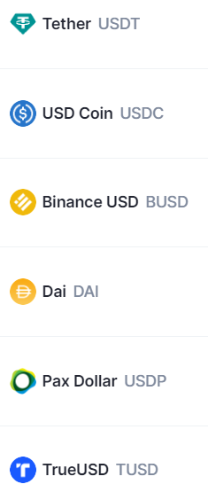
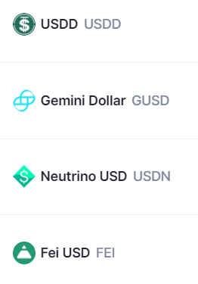

Stablecoins

Slide 6



Stablecoins
Fiat Backed
Over-Collateralized
Algorithmic
Non-Pegged
Fractional

Slide 7
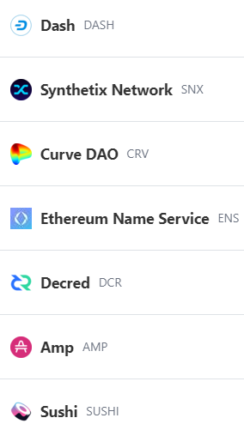
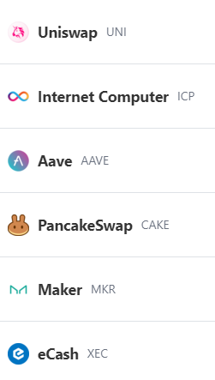
Governance Tokens

Slide 8
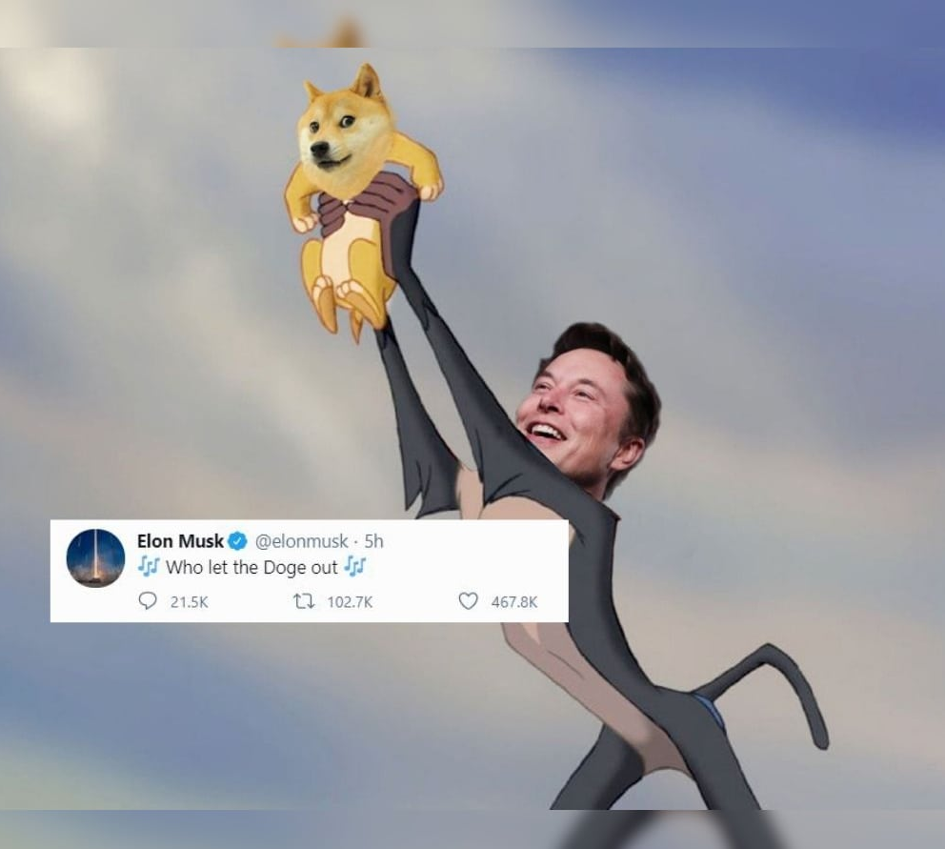
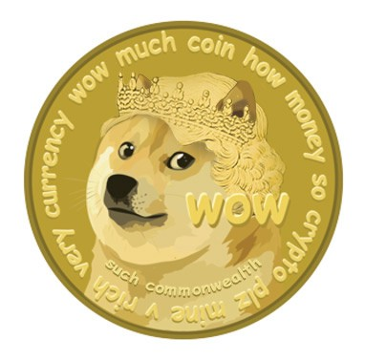

Sh*t coins
TrumpCoin
PutinCoin and Putin Classic
THE SELFIE COIN
DENTACOIN
BANANA COIN
KodakCoin
HOT POTATO COIN
DOGECOIN

Slide 9
Collectible tokens = NFT
Non-fungible tokens (NFT)
$10 = $10
🖼️
Mona Lisa != The Last Supper
Titulo de propiedad != Otro titulo de propiedad
Titulo de carro != Otro titulo de carro
Notes:
NFTs are currently taking the digital art and collectibles world by storm. Digital artists are seeing their lives change thanks to huge sales to a new crypto-audience. And celebrities are joining in as they spot a new opportunity to connect with fans. But digital art is only one way to use NFTs. Really they can be used to represent ownership of any unique asset, like a deed for an item in the digital or physical realm.
If Andy Warhol had been born in the late 90s, he probably would have minted Campbell's Soup as an NFT. It's only a matter of time before Kanye puts a run of Yeezys on Ethereum. And one day owning your car might be proved with an NFT.

Slide 10
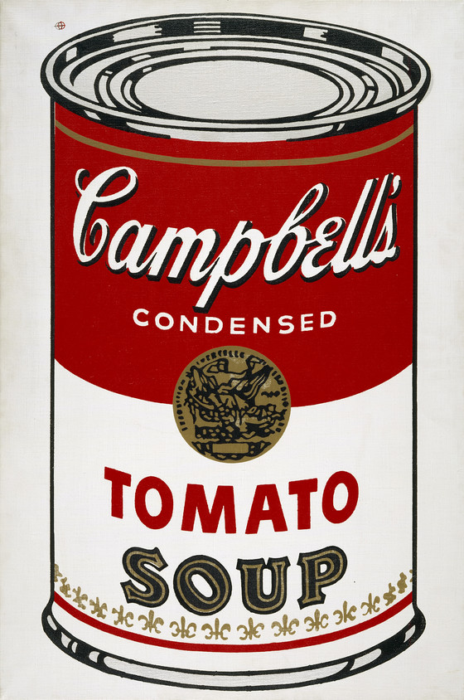
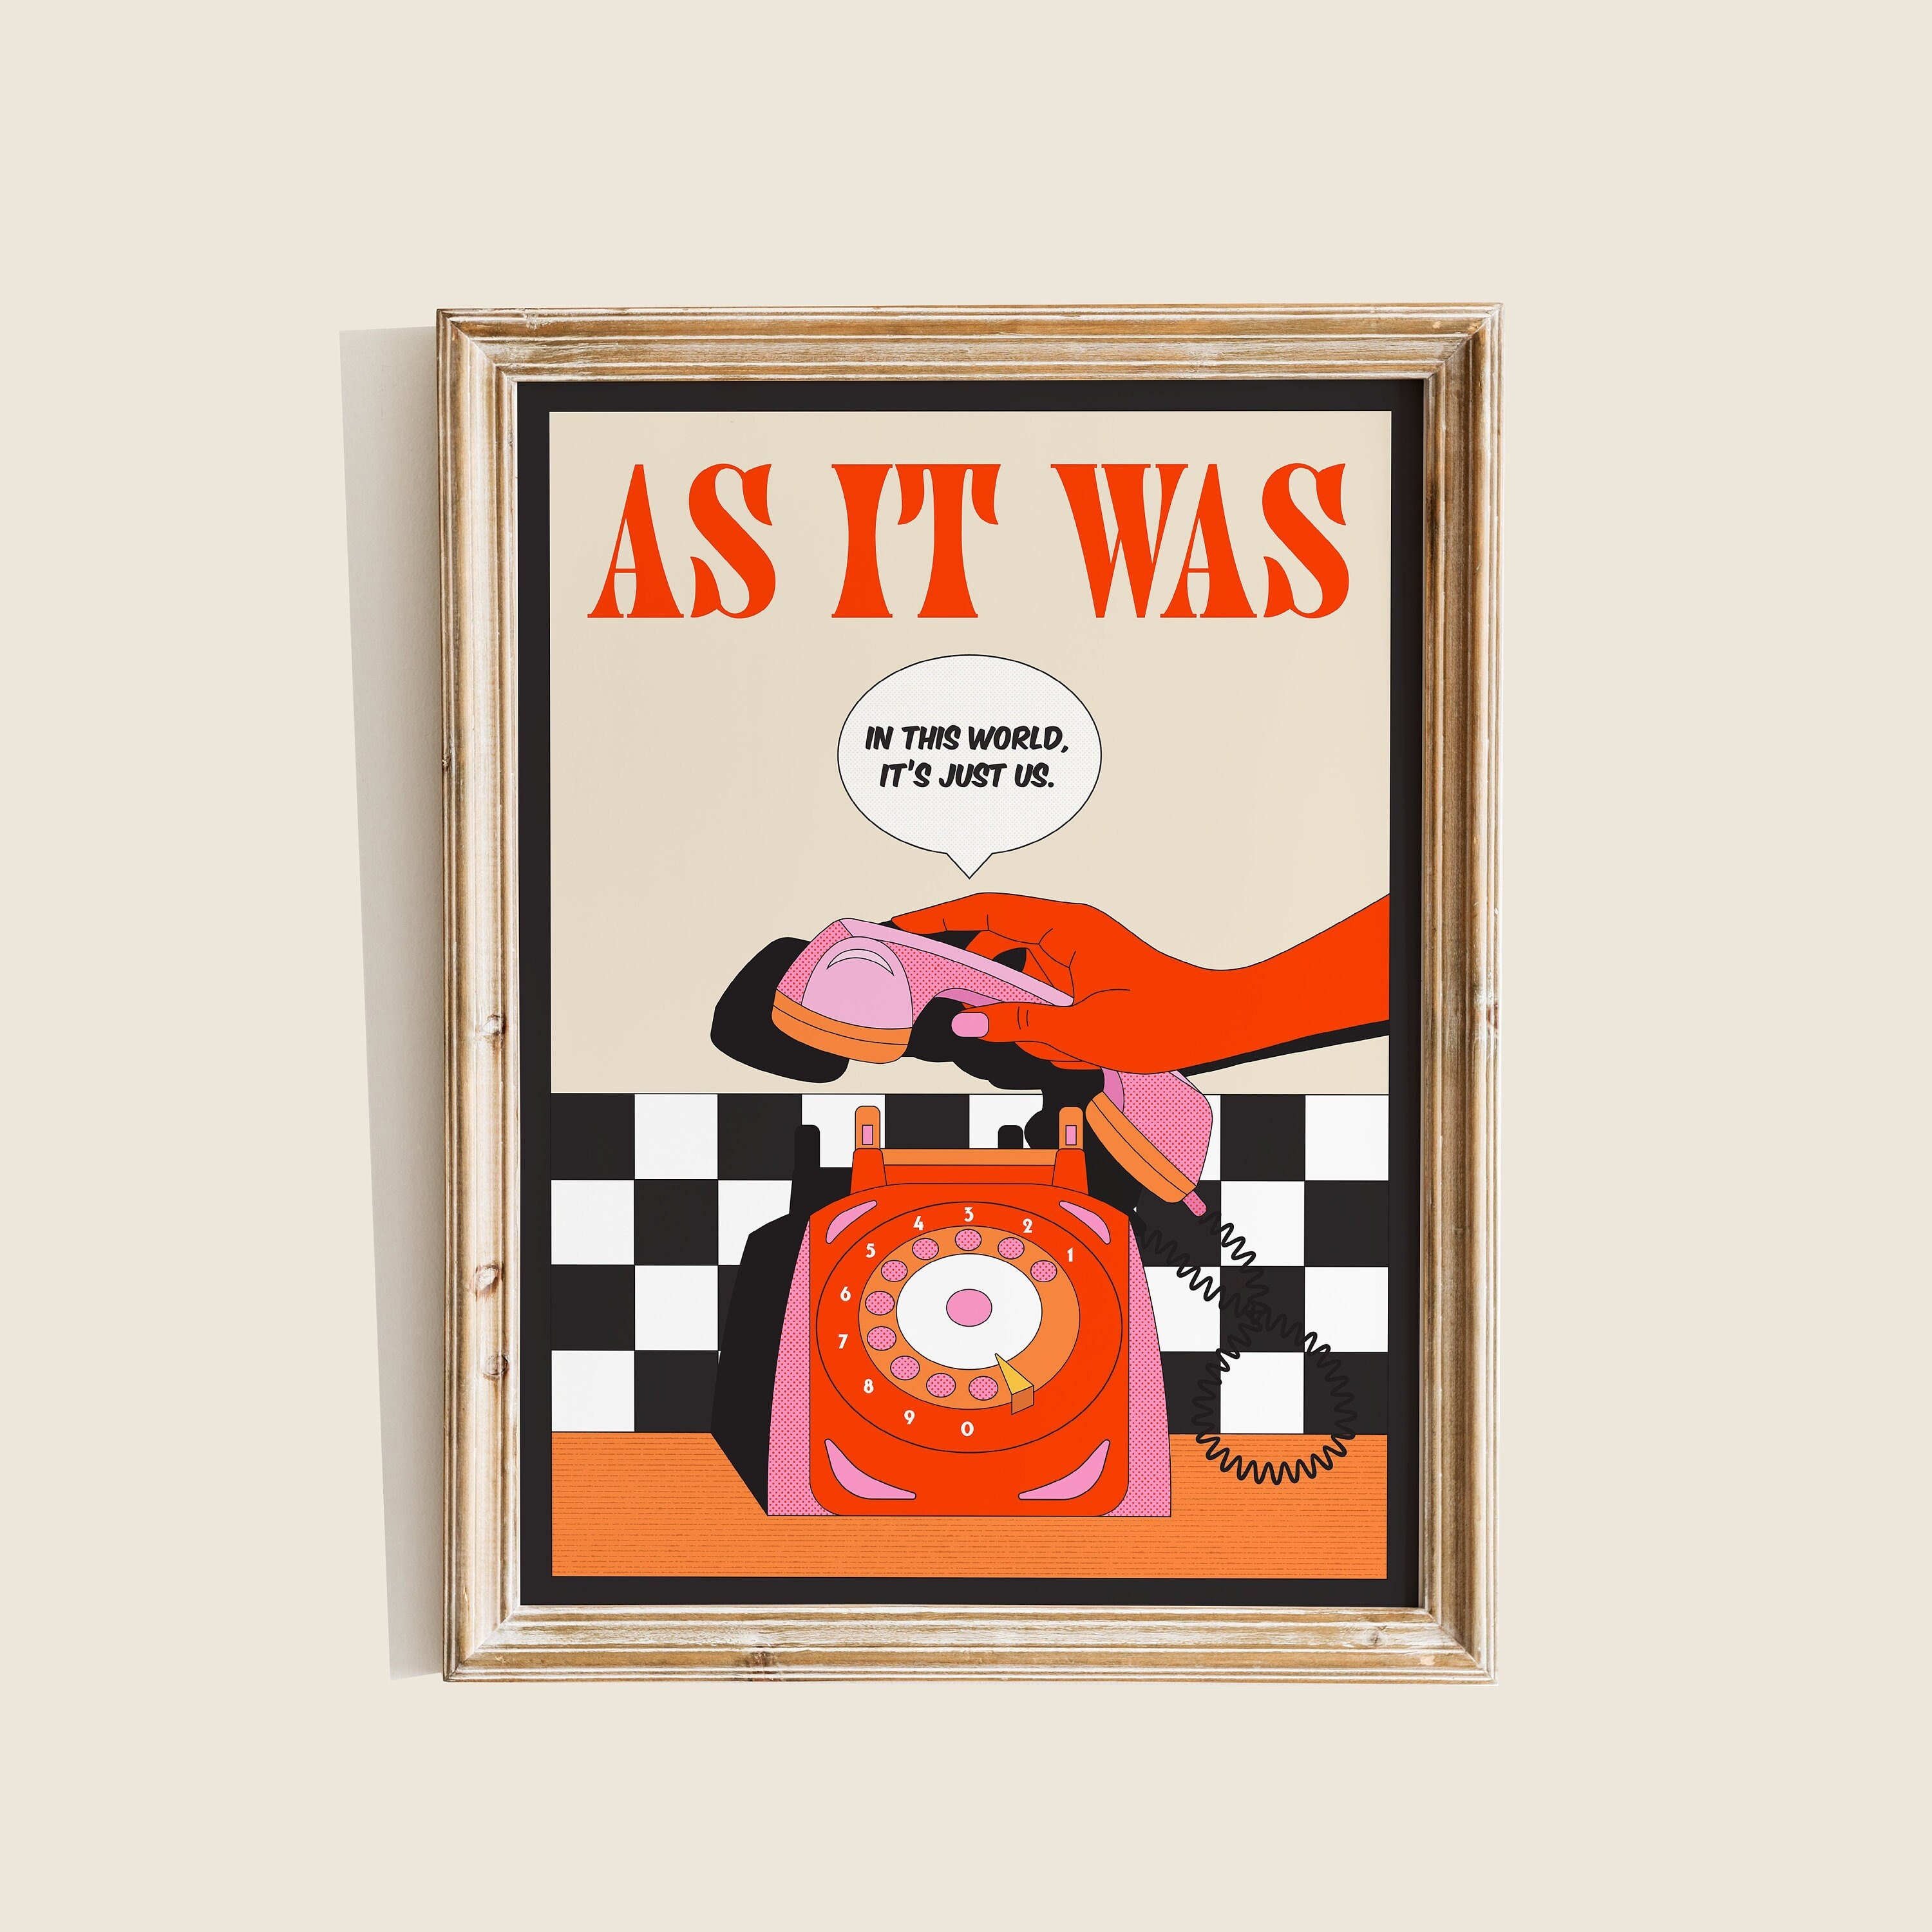

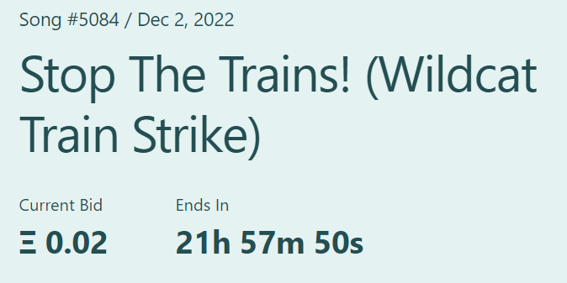
Art & NFTs

Slide 11
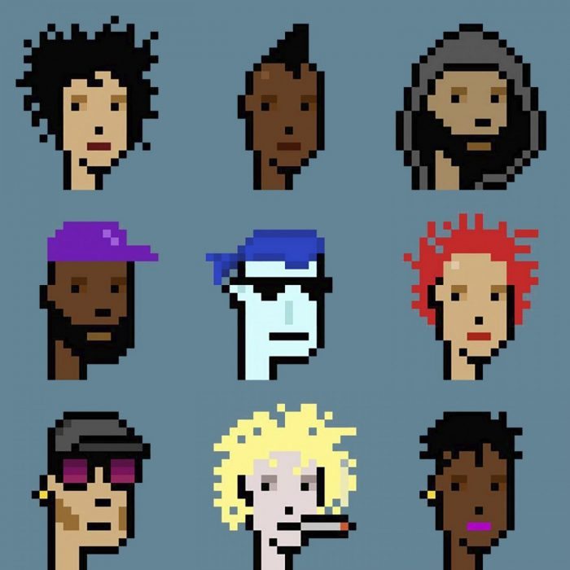
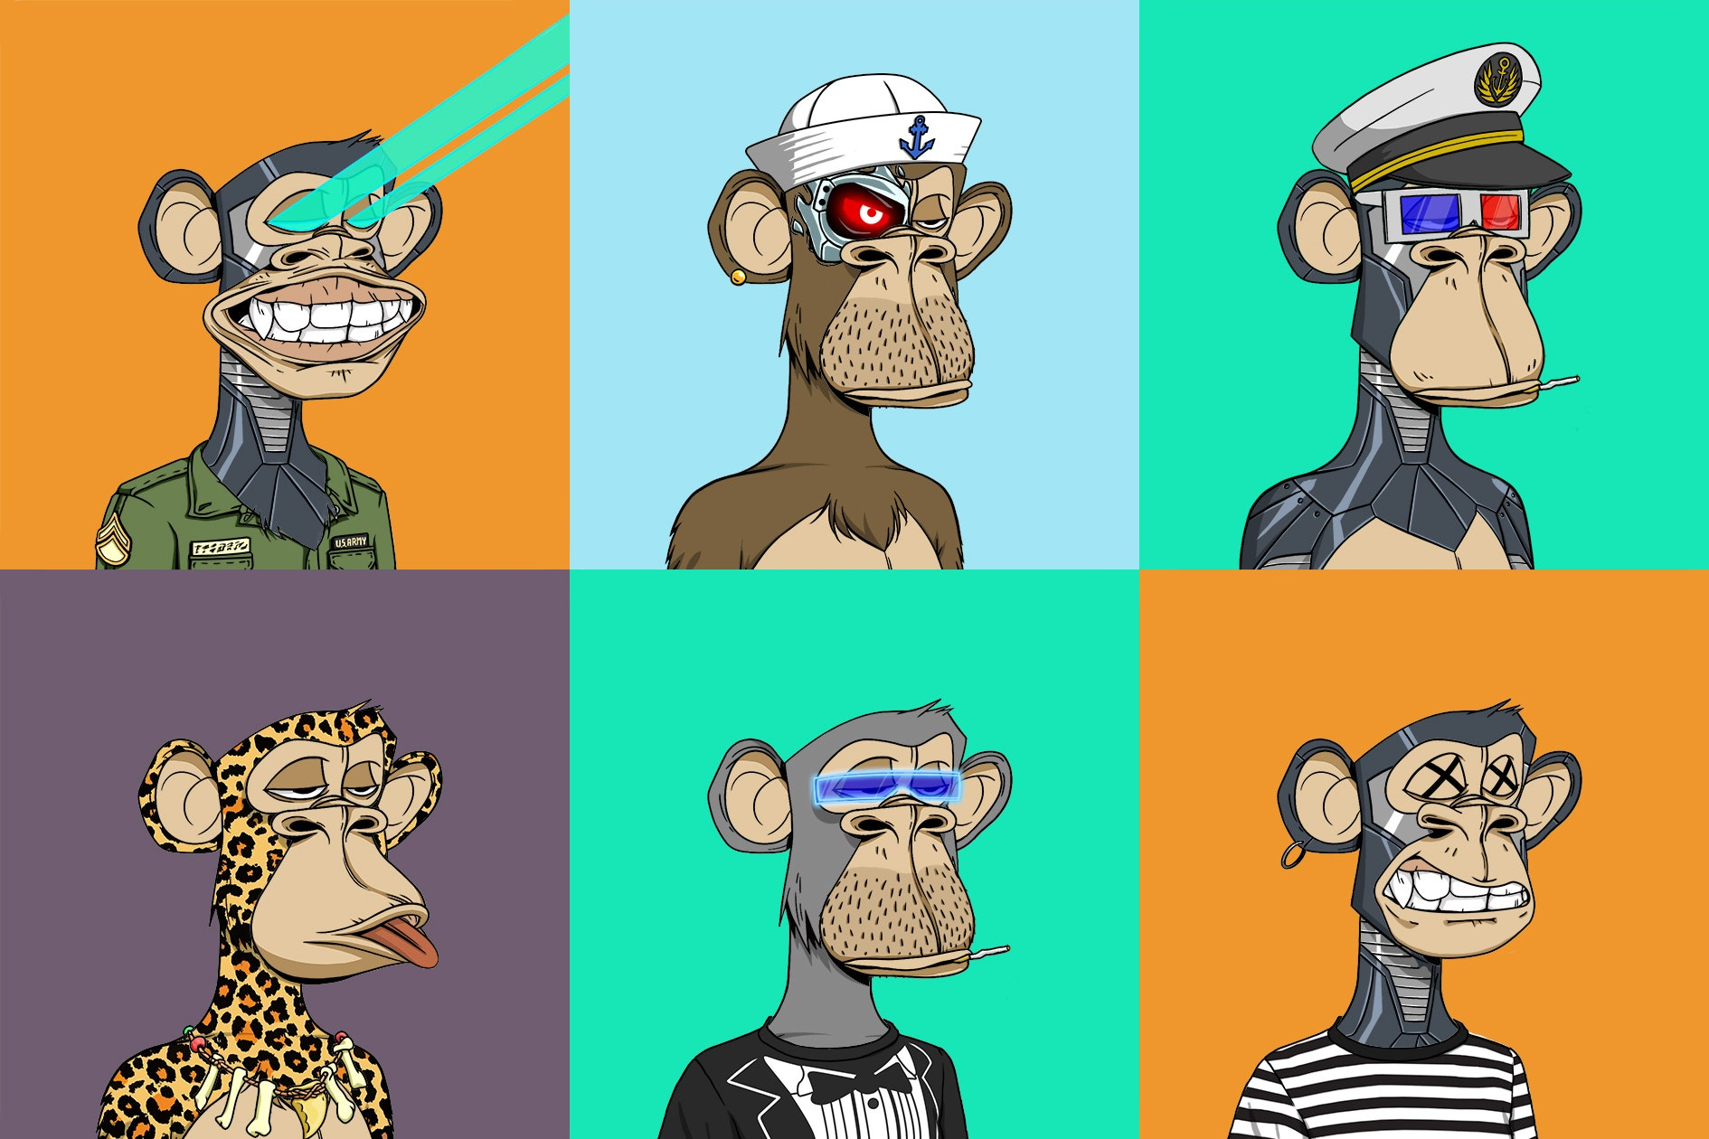
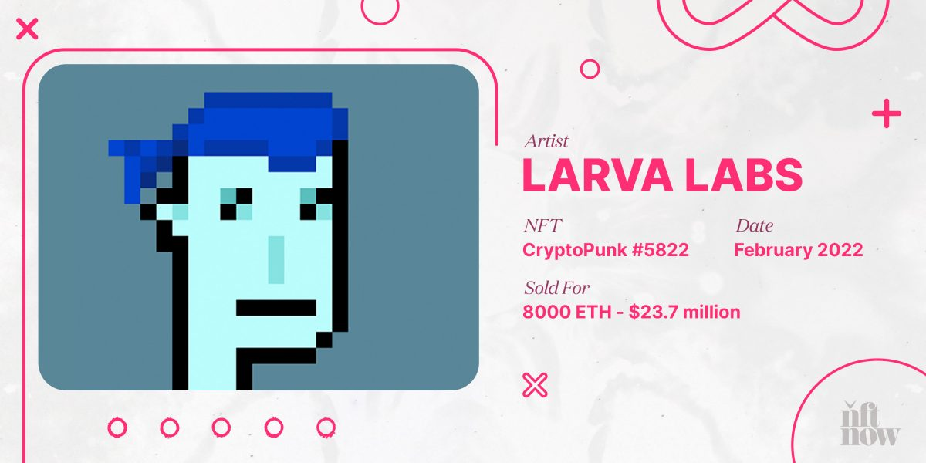
Art & NFTs
Cryptopunks
Bored Apes

Slide 12


NFT as “Title of Asset”
3-bed @ SC
Marketplace
Notes:
References:
- https://www.theblock.co/post/177926/south-carolina-house-sold-as-nft-for-175000

Slide 13
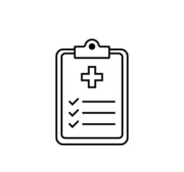

NFT as Mortgage / Medical Data
Mortgage
Health Data
Notes:
References:
https://www.theblock.co/post/177926/south-carolina-house-sold-as-nft-for-175000
https://medicalfuturist.com/nfts-an-health-data/
https://www.benzinga.com/money/will-nfts-revolutionize-the-mortgage-industry

Slide 14
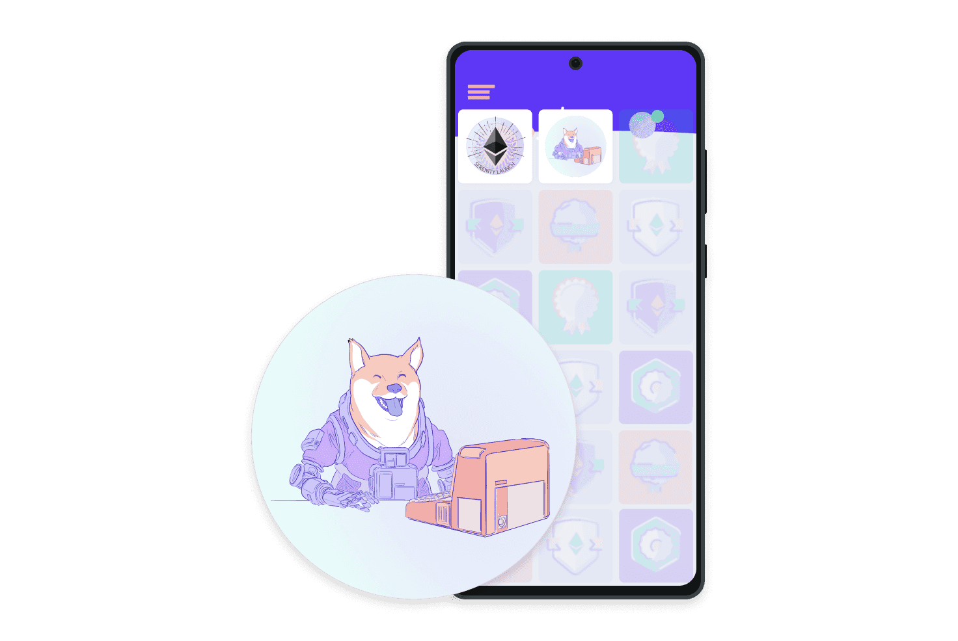
NFT as Memories
POAP
(proof of attendance protocol)
Notes:
References:
https://www.theblock.co/post/177926/south-carolina-house-sold-as-nft-for-175000
https://medicalfuturist.com/nfts-an-health-data/
https://www.benzinga.com/money/will-nfts-revolutionize-the-mortgage-industry

Slide 15
Tokens Standards
These standards help ensure smart contracts remain composable.
Some of the most popular token standards on Ethereum:
ERC-20 - fungible (interchangeable) tokens
ERC-721 - non-fungible tokens
ERC-777 - extra functionality on top of tokens
ERC-1155 - more efficient trades and bundling of transactions (i.e. $BNB, $BAT, CryptoPunks)
ERC-4626 - standards yield-bearing vaults.
Notes:
These standards help ensure smart contracts remain composable, so for instance when a new project issues a token, that it remains compatible with existing decentralized exchanges.
ERC-20 - A standard interface for fungible (interchangeable) tokens, like voting tokens, staking tokens or virtual currencies.
ERC-721 - A standard interface for non-fungible tokens, like a deed for artwork or a song.
ERC-777 - ERC-777 allows people to build extra functionality on top of tokens such as a mixer contract for improved transaction privacy or an emergency recover function to bail you out if you lose your private keys.
ERC-1155 - ERC-1155 allows for more efficient trades and bundling of transactions – thus saving costs. This token standard allows for creating both utility tokens (such as $BNB or $BAT) and Non-Fungible Tokens like CryptoPunks.
ERC-4626 - A tokenized vault standard designed to optimize and unify the technical parameters of yield-bearing vaults.

Slide 16
Quiz - Non-fungible tokens (NFT)
NFTs on Ethereum are harmful to the environment
True
False
Notes:
Since The Merge (transition to proof-of-stake), any transaction has been a negligible impact on the environment.
https://ethereum.org/en/nft/#quiz

Slide 17
Quiz - Non-fungible tokens (NFT)
Two NFTs representing the same artwork are the same thing.
True
False
Notes:
NFTs are non-fungible. This means even if they represent the piece of digital art, they are still uniquely identifible. In the traditional artworld, this might be similar to originals and prints.
https://ethereum.org/en/nft/#quiz

Slide 18
Quiz - Non-fungible tokens (NFT)
NFTs most commonly represent:
A password to your wallet
Ownership of a unique digital item
Your current ETH balance
All of the above
Notes:
NFTs commonly represent ownership of a unique digital item.
https://ethereum.org/en/nft/#quiz

Slide 19
Quiz - Non-fungible tokens (NFT)
NFTs have helped create a new:
Curator economy
Carbon economy
Creator economy
Doge economy
Notes:
NFTs helped create the creator economy.
https://ethereum.org/en/nft/#quiz

Slide 20
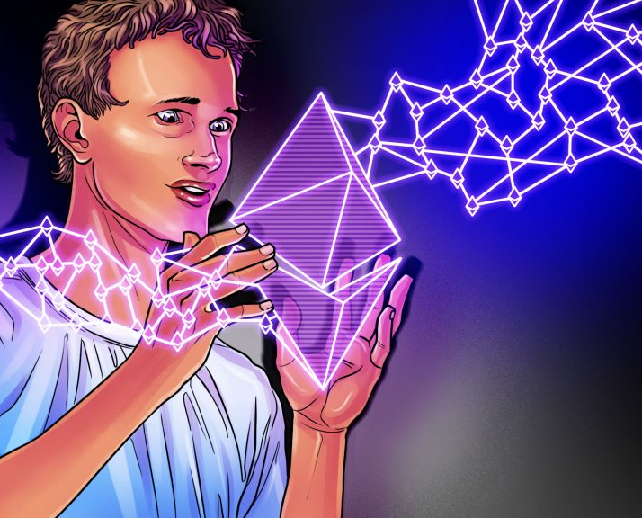
What is next?
EIP-5114: Soulbound Badge
A badge that is attached to a "soul" at mint time and cannot be transferred after that.
EIP-5484: Consensual Soulbound Tokens
Interface for special NFTs with immutable ownership and pre-determined immutable burn authorization

Slide 21
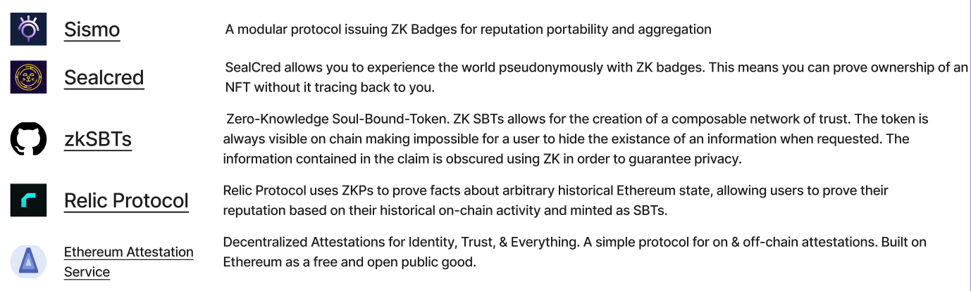
zkID Badges, Reputation and Attestations

Slide 22

Break
Notes:
Q: ¿Dónde se consiguen en Costa Rica?
Creo que: NIMIQ, Cripto-CR
Q: ¿Cuánto cuesta?
A: Alrededor de $100 en el 2022

Slide 23

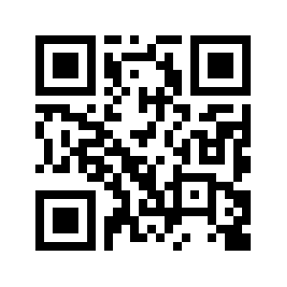
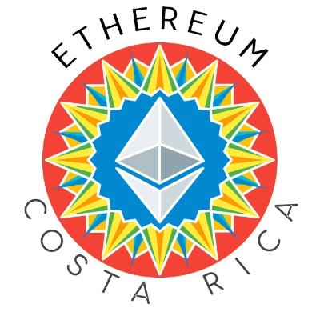




¡Muchas Gracias!
Andy Guzman
https://t.me/EthereumCR

Slide 24
https://nodeguardians.io/
ETH no es la única criptografía en Ethereum
Cualquiera puede crear nuevos tipos de activos e intercambiarlos en Ethereum. Estos se conocen como «tókenes». La gente ha «tokenizado» las monedas tradicionales, sus bienes raíces, su arte e incluso ¡a sí mismos!
Ethereum alberga miles de tókenes, algunos más útiles y valiosos que otros. Los desarrolladores están constantemente creando nuevos tókenes que desbloquean nuevas posibilidades y abren nuevos mercados.
https://ethereum.org/es/eth/#quiz
https://ethereum.org/en/stablecoins/
https://ethereum.org/es/defi/
https://ethereum.org/es/nft/

Slide 25
Quiz - What is Ethereum?
Ethereum’s native cryptocurrency is called:
Ether
Ethereum
Ethercoin
Bitcoin
Notes:
https://ethereum.org/en/what-is-ethereum/#quiz

Slide 26
Quiz - What is Ethereum?
Ethereum consumes more electricity than:
YouTube
Netflix
PayPal
None of the above
Notes:
https://ethereum.org/en/what-is-ethereum/#quiz

Slide 27
Quiz - What is Ethereum?
Since Ethereum launched, how many times has the network went offline?
Never
Once
Four times
More than ten times
Notes:
https://ethereum.org/en/what-is-ethereum/#quiz

Slide 28
Quiz - What is Ethereum?
The biggest difference between Ethereum and Bitcoin is:
Ethereum doesn’t let you make payments to other people
You can run computer programs on Ethereum
You can run computer programs on Bitcoin
They have different logos
Notes:
Ethereum is programmable. This means you can put any computer program on the Ethereum blockchain.
https://ethereum.org/en/what-is-ethereum/#quiz

Slide 29
Quiz - What is Ethereum?
Who runs Ethereum?
Developers
Miners
The Ethereum Foundation
Anyone running a node
Notes:
Anyone running a node is a crucial part of Ethereum’s infrastructure. If you haven’t already, consider running an Ethereum node.
https://ethereum.org/en/what-is-ethereum/#quiz

Slide 30
Quiz - What is Ether?
ETH is valuable because:
ETH is needed to do anything on Ethereum
ETH is an un-censorable peer-to-peer money
ETH is used as collateral for crypto loans
All of the above
Notes:
Ethereum transactions cannot be censored, ETH is required to make any transaction on Ethereum, and it is crucial to the stability of the DeFi ecosystem.
https://ethereum.org/en/eth/#quiz

Slide 31
Quiz - What is Ether?
Staking on Ethereum helps secure the network because:
Stakers can ban people if they don’t like what they are doing
If a staker tries to cheat the network, they risk losing their ETH
Stakers run powerful computers to demonstrate proof-of-work
Stakers undergo KYC before being accepted as a validator
Notes:
Stakers risk losing a significant amount of their ETH if they are shown to be behaving maliciously against the network. This is known as slashing.
https://ethereum.org/en/eth/#quiz

Slide 32
Quiz - What is Ether?
On Ethereum, network fees are paid in:
Bitcoin
ETH
USD
Ethereum
Notes:
Ether (ETH) is native cryptocurrency of Ethereum. All network fees on Ethereum are paid in ETH.
https://ethereum.org/en/eth/#quiz

Slide 33
Quiz - What is Ether?
Ether is also known as:
ETC
ETR
ETH
BTC
Notes:
ETH is the ticker for ether on Ethereum.
https://ethereum.org/en/eth/#quiz

Slide 34
And more quizzes to come…
Introduction to Web3
The Merge
What is layer 2?
Ethereum security and scam prevention
Notes:
Other quizzes
https://ethereum.org/en/web3/#quiz
https://ethereum.org/en/upgrades/merge/#what-is-the-merge
https://ethereum.org/en/layer-2/#quiz

Slide 35
